Slide 1

Heat and Thermodynamics
Dr. Md. Anisur Rahman
Assistant Professor (Physics)
University of Asia Pacific
Dhaka, Bangladesh

Slide 2
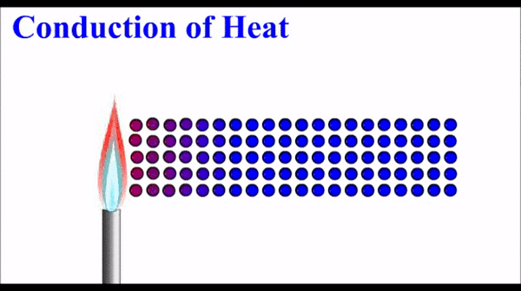

Roughly, heat means "energy in transit" (i.e. the energy which crosses the system boundaries. Whereas Enthalpy refers to total heat content in a system) and dynamics relates to "movement"; thus, in essence thermodynamics studies the movement of energy and how energy instills movement.
Our Universe itself is a largest thermodynamic system and mainly it is all about energy.
Thermal energy refers to the energy stored in the random motion of the molecules (translation, rotation, vibration).

Slide 3
Applications of Thermodynamics:
One of the important fields of thermodynamics is heat transfer, There are three modes of heat transfer: conduction, convection and radiation. The concept of heat transfer is used in wide range of devices like heat exchangers, evaporators, condensers, radiators, coolers, heaters, etc.
Thermodynamics also involves study of various types of power plants like thermal power plants, nuclear power plants, hydroelectric power plants, power plants based on renewable energy sources like solar, wind, geothermal, tides, water waves etc.
All the refrigerators, deep freezers, industrial refrigeration systems, all types of air-conditioning systems, heat pumps, etc. work on the basis of the second law of thermodynamics.

Slide 4
Three different forms of heat:
Sensible heat-It is that kind of heat which goes to rise the temperature of a body.
Latent heat-which goes to change the state of a body without any change of temperature.
Radiant heat-is that heat which comes to the surface of the earth from the sun by the method of radiation.

Slide 5
Heat and Temperature
The quantity of thermal energy present in a body is called ‘heat’ whereas the degree of hotness or coldness of a body is given by temperature.
The total kinetic energy possessed by all the molecules of a body gives us the idea of heat while the average kinetic energy possessed by a molecule gives us the temperature of the body.
Heat is measured by the product of mass, specific heat and the temperature of the body. Its unit is Joule. Temperature is measured by instruments called thermometers. Its units are F, C and K.

Slide 6
A pyrometer is a type of thermometer used to measure high temperatures by utilizing its electromagnetic radiation without any physical contact.
Types of pyrometer: Radiation Pyrometer, Optical Pyrometer, Thermo-Electric Pyrometer, Photoelectric Pyrometer.
Principle of Pyrometer: Its principle depends upon the relationship between temperature of a hot body and electromagnetic radiation emitted by the body.

Slide 7
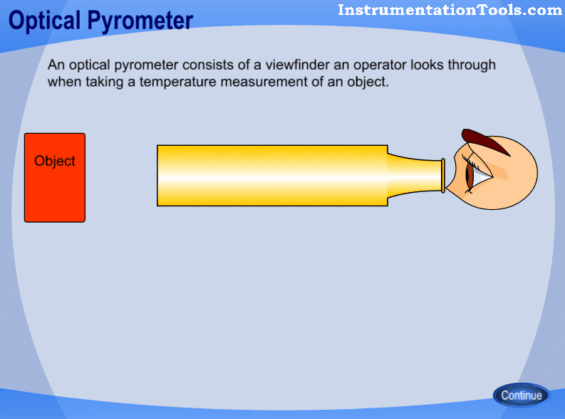
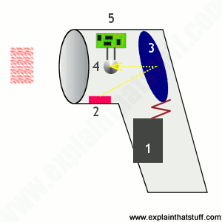
Radiation pyrometers measures the radiant energy emitted or reflected by a hot object.
Optical Pyrometer works on the principle of matching the brightness of an object to the brightness of the filament which is placed inside the pyrometer by regulating the current. When the light intensity of any wavelength depends on the temperature of the radiating object, then the flow of current through the lamp becomes a measure of the temperature source when adjusted.

Slide 8
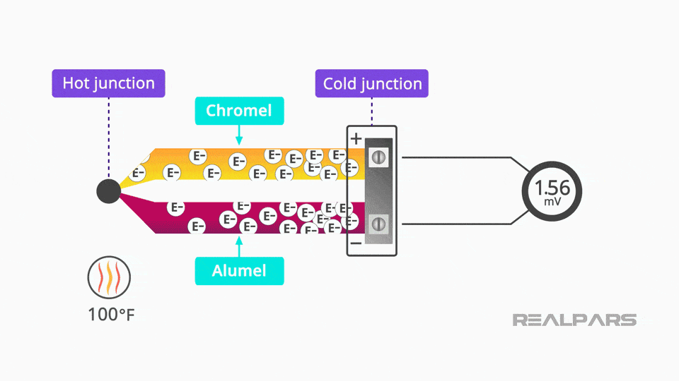
Thermoelectric Pyrometer: Thermocouple
Thermo Electric Pyrometer is an instrument used to measure very high temperatures such as the temperature of a furnace. It worked on the principle of thermo electric effect.

Slide 9
Origin of Thermo-E. M. F
In the electron theory of metal, the electrons are assumed to move freely in the interior of metals like molecules in a gas and exert a pressure, which has different values for different metals at a given temperature. So, the electron densities are different in the different metals at the same temperature. When the two metals are brought in contact with each other, electrons have a tendency to flow from the metal of higher electron density to the metal of lower electron density. Thus an electrostatic field and hence a potential difference is set up between them; the strength of the electric field will depend upon the temperature and the metal forming the junctions.

Slide 10
The pair of metals with which a thermo-electric current is produced is called a thermo-couple. (Sb, Fe, Cd, Zn, Ag, Au, Rb, Mo, Cr, Sn, Pb) Hg, Cu, Pt, Co.
Metals to the right of Pb (lead) are called thermoelectrically positive, while those to its left are thermoelectrically negative.
Types of thermocouples:
➢ Copper-constantan thermocouple - up to 300 °C.
➢ Iron- nickel - 300 °C to 600 °C.
➢ Nickel-nichrome - 600 °C to 1600 °C.
➢ Platinum, rhodium - 1000 °C to 1600 °C.
➢ Iridium and alloy of iridium ad rubidium 1600 °C to 2000 °C.
➢ Tungsten and molybdenum - 2000 °C to 3000 °C.

Slide 11
There are three major effects involved in a thermocouple circuit: the Seebeck, Peltier, and Thomson effects.
Seebeck Effect: When two dissimilar metals are joined together at two junctions and maintained a closed circuit, an electromotive force (emf) is produced within the circuits due to different electron density of the two (dissimilar) metal
Peltier Effect: When two dissimilar metals are joined together to form two junctions, an emf is generated within the circuit due to the different temperatures of the two junctions of the circuit.
Thomson effect is the evolution or absorption of heat when electric current passes through a circuit composed of a single material that has a temperature difference along its length.

Slide 12
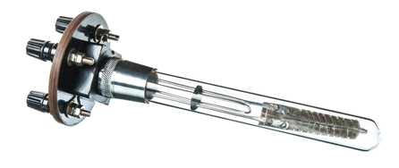
Platinum Resistance Thermometer
Sir William Siemens in 1871, first constructed a platinum resistance thermometer based on the principle of wheat stone bridge but the construction details of his instrument was not quite satisfactory. Later Callendar and Griffiths modified and produced a modern type of platinum resistance thermometer.
The Platinum Resistance Thermometer is based on the principle of change of resistance with change in temperature.

Slide 13
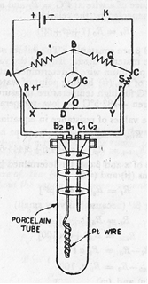
Working principle
A platinum resistance thermometer consists of a pure platinum wire wound in a double spiral to avoid inductive effects. The wire is wound in a mica plate. The two ends of the platinum wire are connected to thick copper leads and connected to the binding terminals B1 and B2. For higher temperatures the leads are of Platinum. C1 and C2 are the compensating leads exactly similar and of the same resistance as the leads used with the Platinum wire. The platinum wire and the compensating leads are enclosed in a glazed porcelin tube. The tube is sealed and the binding terminals are provided at the top. The leads pass through mica discs which offer the best insulation and also prevent convection currents.

Slide 14
The resistance of a wire at t °C = R_{t} and 0 °C = R₀. These resistances are connected by the relation R_{t} = R₀(1 + αt + βt²) …….(i)
α and β are the coefficient of increase of resistance with temperature. The values of α and β depend on the nature of the material of the wire. For pure platinum, α = 0.00394 and β= -0.00000058. Since β « α, It is more convenient to neglect the term involving β in eq. (1).

Slide 15
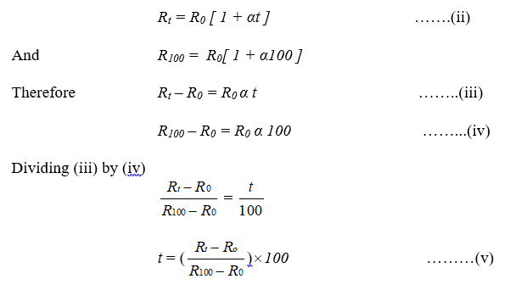

Slide 16
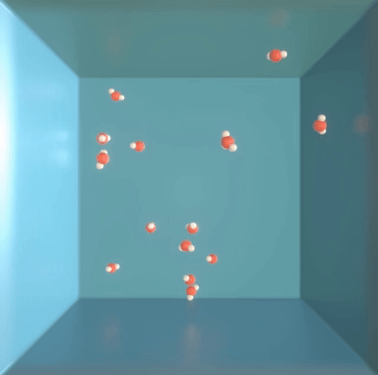
Kinetic theory of gases
Kinetic theory of gases posits that pressure is due not to static repulsion between molecules, as was Isaac Newton's conjecture, but due to collisions between molecules moving at different velocities. Kinetic theory is also known as the kinetic-molecular theory or the collision theory.

Slide 17
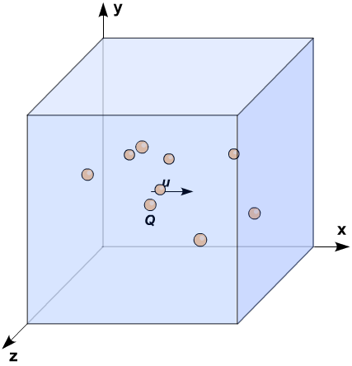
The theory for ideal gases makes the following assumptions:
• The gas consists of very small particles.
• These molecules are in constant, random motion.
• The collisions of gas particles with the walls of the container holding them are perfectly elastic.
• The molecules are perfectly spherical in shape, and elastic in nature.
• The average kinetic energy of the gas particles depends only on the temperature of the system.

Slide 18
Differences between Ideal (Perfect) and Real Gases
[1] A gas which rigidly obeys the Boyle’s and Charle’s law at all temperatures and pressures is called a perfect gas.
[2] Ideal gas can be cooled to -273 ͦ C to reduce its volume to zero.
[3] The ideal gas molecules do not have any volume and they do not attract each other.
[1] The Real gas does not obey the Boyle’s or Charle’s law at high pressures and at low temperatures.
[2] The real gas cannot be cooled to -273 °C so that its volume becomes zero. Actually all real gases become liquid before reaching the temperature of -273 °C.
[3] The real gas molecules of a particular gas have a volume of their own (however small they are).

Slide 19
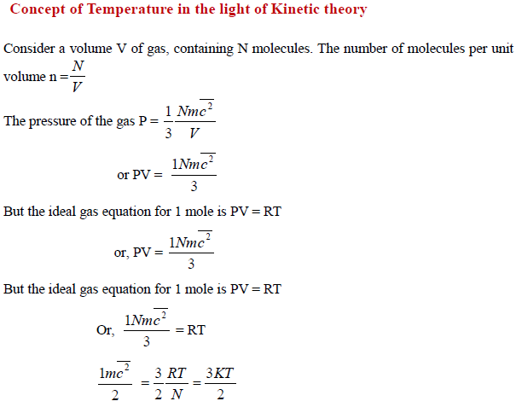

Slide 20
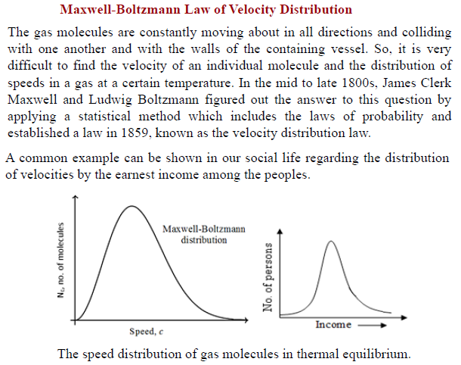

Slide 21
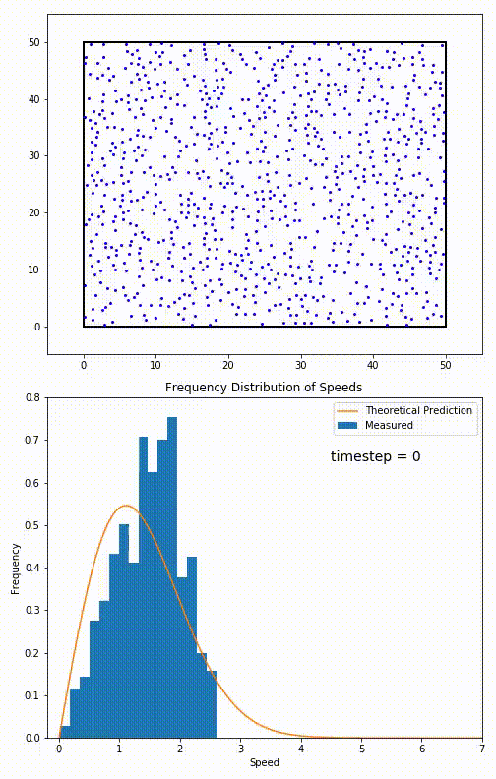

Slide 22
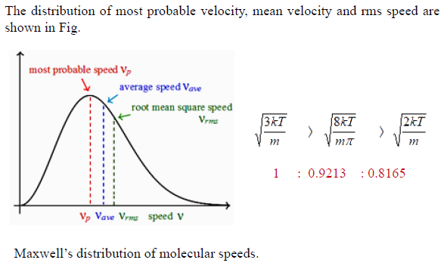

Slide 23


